Slide 1
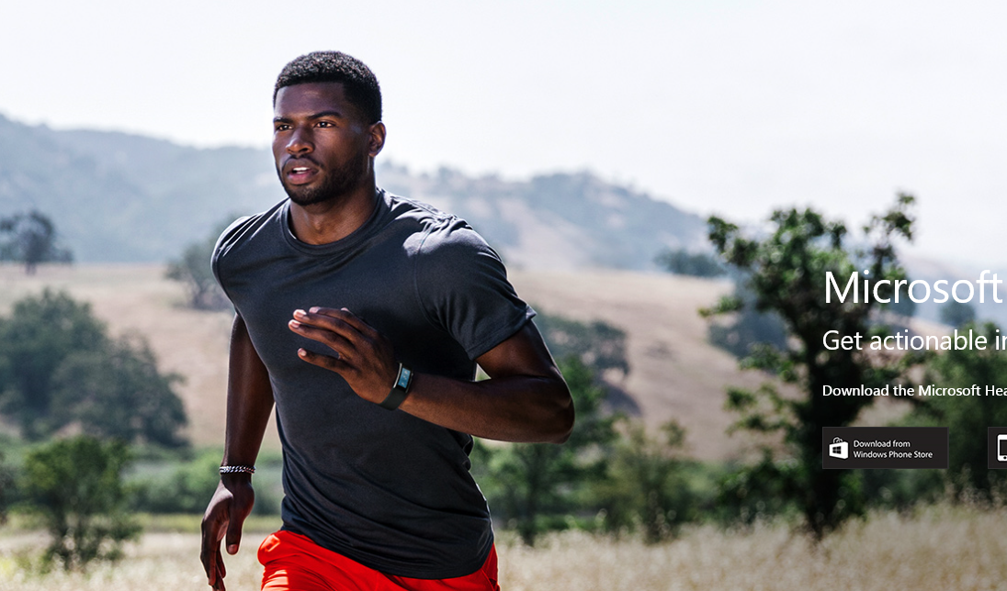
IoT and the Microsoft Intelligent Cloud – your competitive advantage
David.Gristwood@microsoft.com
@ScroffTheBad

Slide 2



From large scale….
“The more data we have, the more we can learn and put together algorithms to predict problems. It’s about taking information to make systems even more efficient and productive.”
DOUG WEBER
BUSINESS MANAGER,
REMOTE APPLICATION MONITORING
ROCKWELL AUTOMATION
Notes:
https://www.youtube.com/watch?v=TSdicQh0dTI
Key points:
Rockwell Automation is an industrial automation company from Milwaukee, WI
Developed a solution that enables petroleum industry customers to monitor their expensive capital assets and provide near-real-time insight into the operation of machinery (often in remote, isolated regions)
This allows customers to reduce downtime and maintenance of assets, increasing productivity
From this original solution, Rockwell was able to expand their asset monitoring and management capabilities by incorporating big-data analytics tools from Microsoft Azure, allowing them to analyze massive amounts of raw telemetry data and manage complex data interactions across multiple systems
This provides their customers with advanced analytics that provide actionable information to inform their business decision-making
Presenter guidance:
Unless your audience is very IT-savvy, keep the information at a high-level
Potentially frame this as:
Problem: For petroleum industry customers, managing and operating their machinery and other assets is a constant challenge. These machines are expensive, remote, and often hard to get to. Unexpected downtime and increased maintenance of assets for Rockwell’s petroleum industry customers was impacting their productivity and increasing costs over time
Solution: Rockwell develop an IoT solution that provided remote asset monitoring and management capabilities
Customer impact: Rockwell’s customers were able to reduce downtime and maintenance of assets, increasing productivity
Partner outlook: Rockwell was able to expand their asset monitoring and management capabilities by incorporating big-data tools from Microsoft Azure, allowing them with massive amounts of data and manage complex interactions across customers – enabling them to provide their customers with new and improved services
For customers who want more information, use the “Watch Video” button in the bottom left-hand corner to show them the video case study
Talk track:
An industrial automation company based out of Milwaukee, Wisconsin, Rockwell Automation is using IoT to help customers transform their operations within the petroleum industry. Their solution monitors expensive capital assets, and provides a near-real-time view of the operation of machinery in remote, isolated regions. Because Rockwell is now able to remote monitor assets worldwide, they are able to reduce costly downtime and maintenance of assets, and increase productivity. As a result of Rockwell’s end-to-end approach, customers are changing the way they manage their entire oil and gas supply chain.
And Rockwell didn’t stop there. They soon expanded on the asset monitoring and management capabilities of their solution to include a broad data strategy that incorporates big-data analytics tools, including Azure HDInsight and Azure Data Factory, to allow them to manage complex data interactions across multiple systems and analyze massive amounts of raw telemetry data. For customers, this advanced analytics feature brings actionable, predictive information that facilitates and informs business decision-making.
Harnessing the potential of the data collected from the ocean floor to the gas pump on the corner, Rockwell Automation is using IoT to light up traditional pump, transport and metering equipment with cloud-connected sensors, and is providing customers with new forms of insight and value that even they didn’t expect at the time of developing the solution. It’s all about capturing new data streams, and turning that data into insights and action.
<Click>

Slide 3

…. to this

Slide 4


















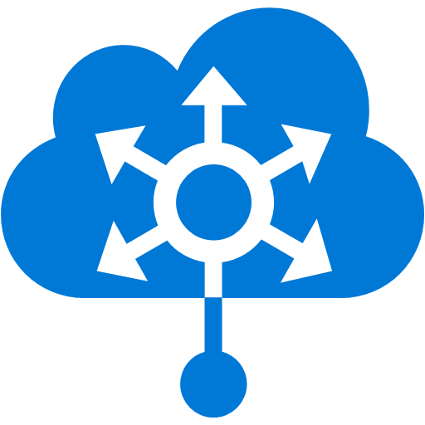

































Platform Services (“micro-services”)
Security & Management
Compute
Web and Mobile
Developer Services
Hybrid
Operations
Cloud
Services
Service
Fabric
Web Apps
API
Apps
API
Management
Visual Studio
Azure SDK
Portal
Azure AD
Connect Health
Batch
Remote App
Mobile
Apps
Logic
Apps
Notification
Hubs
Team Project
Application
Insights
Active
Directory
AD Privileged
Identity
Management
Multi-Factor
Authentication
Integration
Analytics & IoT
Data
Backup
Storage
Queues
Biztalk
Services
Automation
HDInsight
Machine
Learning
SQL
Database
SQL Data
Warehouse
Operational
Insights
Hybrid
Connections
Service
Bus
Key Vault
Data
Factory
IoT and Event
Hubs
Redis
Cache
Search
Import/Export
Store /
Marketplace
Media & CDN
Site
Recovery
Stream
Analytics
Mobile
Engagement
DocumentDB
Tables
VM Image Gallery
& VM Depot
Media
Services
Content Delivery
Network (CDN)
StorSimple
Infrastructure Services
Compute
Storage
Networking
Virtual Machines
Containers
BLOB Storage
Azure Files
Premium Storage
Virtual Network
Load Balancer
DNS
Express
Route
Traffic Manager
VPN Gateway
Application Gateway
Datacenter Infrastructure (24 Regions, 19 Online)

Slide 5







Analytics and IoT - Transform data into intelligent action
Information Management
Big Data Stores
Machine Learning and Analytics
Dashboards and Visualizations
Business apps
Power BI
Azure
Data Factory
Azure
Machine Learning
Personal Digital Assistant
Azure
Data Lake store
Cortana
Azure Data Lake analytics service
People
Custom apps
Azure
Data Catalog
Perceptual Intelligence
Azure HDInsight
(Hadoop and Spark)
Face, vision
Azure
SQL Data Warehouse
Speech, text
Azure
IoT Hub
Azure
Stream Analytics
Business Scenarios
Sensors and devices
Recommendations,
customer churn,
forecasting, etc.
Automated Systems
DATA
INTELLIGENCE
ACTION

Slide 6
Connect & Control Azure IoT Hub

Slide 7


Azure IoT Hub
Telemetry ingestion
Millions of devices
Secure bi-directional communication
AMQP, HTTP, MQTT, custom protocols
Multiple platforms device SDKs
IoT Hub
Event processing and insight
(e.g., hot and cold paths)
IP-capable
Cloud protocol
gateway
Device business logic,
connectivity monitoring
Field gateway
PAN-devices
Application device provisioning and management
field
cloud

Slide 8
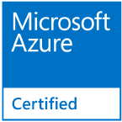
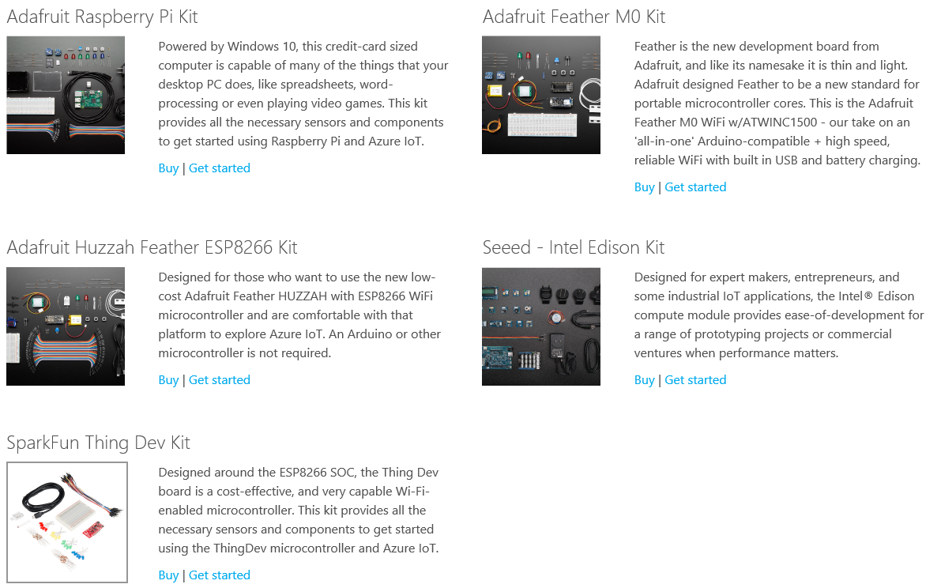
Azure IoT Starter Kits
Five ‘Azure Certified for IoT’ development boards, with actuators, sensors, etc.
Designed to quickly and inexpensively build IoT prototypes

Slide 9
Azure IoT Hub and Devices
Azure IoT Hub device management
Easier and more cost-effective to remotely maintain, interact with and manage IoT devices at scale
Manage millions of devices supporting the LWM2M protocol
Azure IoT Gateway SDK preview
Enables legacy devices and sensors to connect to the Azure cloud without having to replace existing infrastructure
Basis for edge intelligence capabilities such as encryption, annotation, pre-processing, filtering, etc.
Notes:
https://azure.microsoft.com/en-us/blog/microsoft-announces-two-new-offerings-to-streamline-iot-management/

Slide 10
Event Processing Azure Stream Analytics

Slide 11
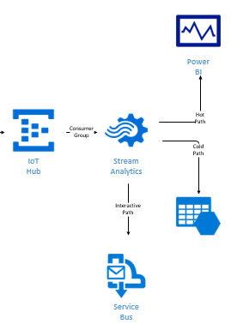
Real time event processing
Uncover real time insights
Perform real time analytics across multiple streams
Rapid Deployment
Use simple SQL syntax, auto distributed for scale
Mission critical reliability
Fully managed, low latency, high throughput
Create real time alerts
Flag alerts and alarms for attention
High volume and Scale
Analyze millions of data points per second
Notes:
ASA can not only handle millions of events per second but it can also correlate across multiple independent streams of data simultaneously. This high speed event processing allows for the real time detection of anomalies or escalations based on threshold breaches or alarm settings as the data is ingested. The architecture is simple and easily scalable to an enterprise ready solution.
Azure Stream Analytics:
Real time analytics
Millions of events per second
Low latency, high througput

Slide 12

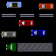
Working with Streaming Data
Data at Rest
Data in Motion

Slide 13
Windowing Concepts
Windows can be tumbling, hopping, sliding
Windows are fixed duration
Timestamp of end of the window
A 10-second Hopping Window with a 5-second “Hop”
1
5
4
6
2
8
6
5
3
6
1
0
5
10
15
20
25
30
Time
(secs)
1
5
4
6
2
4
6
2
“Every 5 seconds give me the count of tweets over the last 10 seconds”
8
6
8
6
5
3
SELECT Topic, Count(*) AS TotalTweets
FROM TwitterStream
TIMESTAMP BY CreatedAt
GROUP BY Topic, HoppingWindow(second, 10, 5)
5
3
6
1

Slide 14
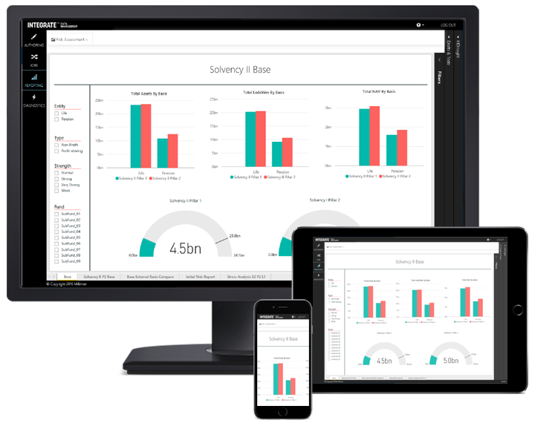
Data Visualization Power BI

Slide 15
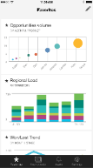
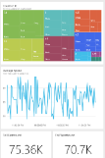
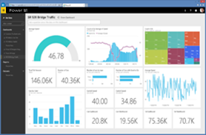
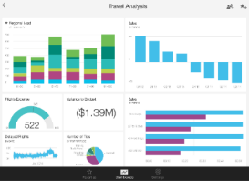
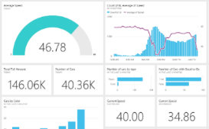
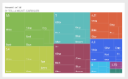
Microsoft Power BI
Data sources
Power BI
SaaS solutions
e.g. Marketo, Salesforce, GitHub, Google analytics
Content packs
Natural language query
Sharing & collaboration
On-premises data
e.g. Analysis Services
Live dashboards
Organizational content packs Corporate data sources or external data services
Visualizations
Azure services
Azure SQL, Stream Analytics…
Reports
Excel files
Workbook data / data models
01001
10101
Power BI Desktop files
Data from files, databases, Azure, and other sources
Datasets
Data refresh
Create beautiful visualizations to tell compelling data stories Build rich, live dashboards that turn business intelligence into real insights
Notes:
1. The Power BI service, sometimes referred to as powerbi.com, is what allows you to:
Create beautiful visualizations to tell compelling data stories
Build rich, live dashboards that turn BI into business insights
Create reports & datasets from which you can create visualizations and dashboards
Enjoy the benefits of up-to-date data with real-time, automatic and scheduled refreshes
Share dashboards easily with other people in your organization
Ask questions of data in plain English with Natural Language Query
Stay connected to your data all the time with mobile applications
2. Power BI connects to a variety of data sources. These range across both cloud and on-premises sources, and include:
A variety of popular SaaS solutions, such as Marketo, Salesforce, GitHub, Dynamics CRM, Zendesk, and several others
On-premises databases – Power BI offers live connectivity to SQL Server Analysis Services, which we’ll cover in more detail later. And using a gateway solution, Power BI can connect to other database solutions.
Custom data sources – Power BI can connect to any data source you need it to thanks to its extensibility via REST APIs. This includes both proprietary corporate data sources, as well as external data services. For example, if you are a SaaS solution provider, you can work with Microsoft to connect your solution to Power BI.
Other Azure services – Power BI integrates tightly with SQL Azure and Stream Analytics, and will be integrating closely with more Azure services over time
Power BI Desktop and Excel files – Excel workbooks can be directly connected to Power BI.com, or may be used with Power BI Desktop. Power BI Desktop is a companion application to the Power BI service – it is a desktop tool that supports data analysis and reporting. Like Excel files, Power BI Desktop files may be uploaded to the Power BI service.

Slide 16
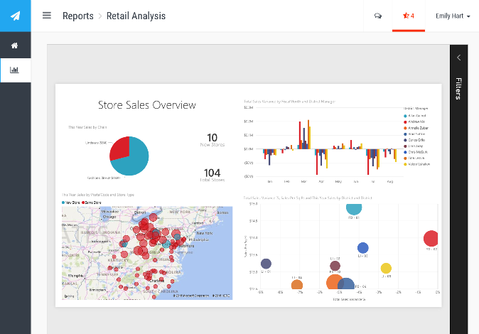
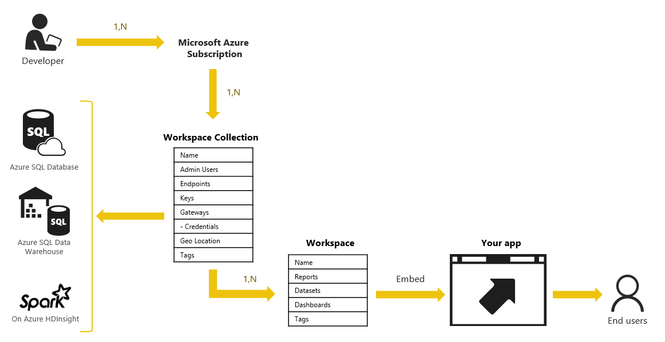
Power BI Embedded
“Dashboard as a service” embedded directly into applications
Native Azure service
Priced at $2.50/1K renders

Slide 17
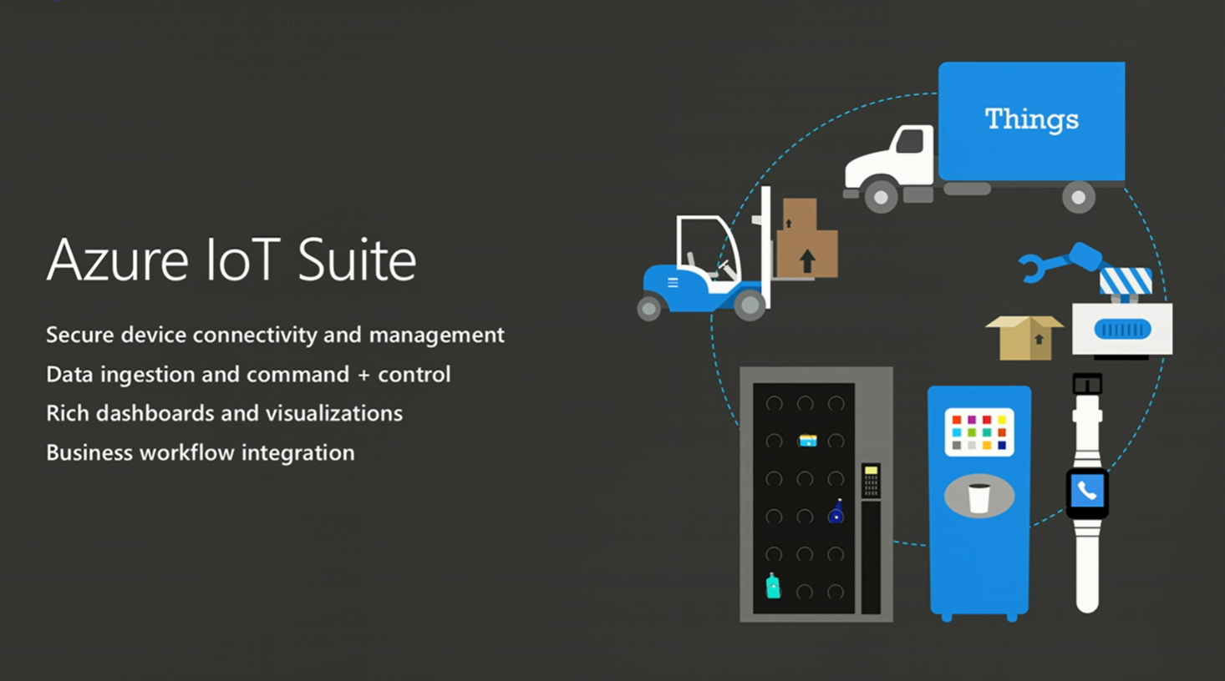

Slide 18
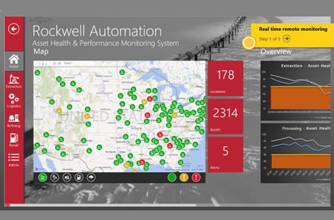
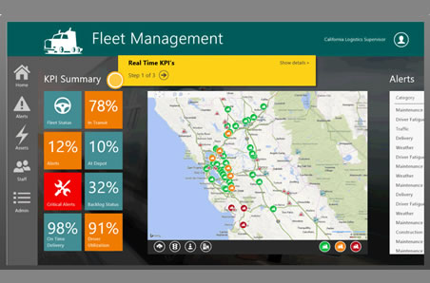
Azure IoT Suite
Predictive maintenance
Predict equipment failures before they happen, and systematically prevent them—even for millions of machines spread across the globe. Predictive maintenance solutions take advantage of streaming data from sensors and devices to recognize warning signs, predict when equipment needs maintenance, and pre-emptively service that equipment before costly repairs are needed.
Remote monitoring
How do you know if your oil pipes located in remote Alaska need repairs? Now, assets located anywhere can be monitored from afar. Remote monitoring solutions collect live data from assets, and use that data to trigger automatic alerts and operational actions based on current conditions, such as remote diagnostics and maintenance requests. Go from a manual, costly procedure to one that is dynamic and automated.
www.AzureIoTsuite.com

Slide 19
Azure IoT Suite - Remote Monitoring
Web/Mobile App
Power BI
Storage blobs
DocumentDB
IoT Hub
Stream Analytics
Event Hub
Web Jobs
Logic Apps
Azure
Active Directory

Slide 20
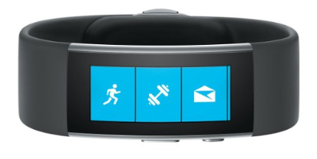
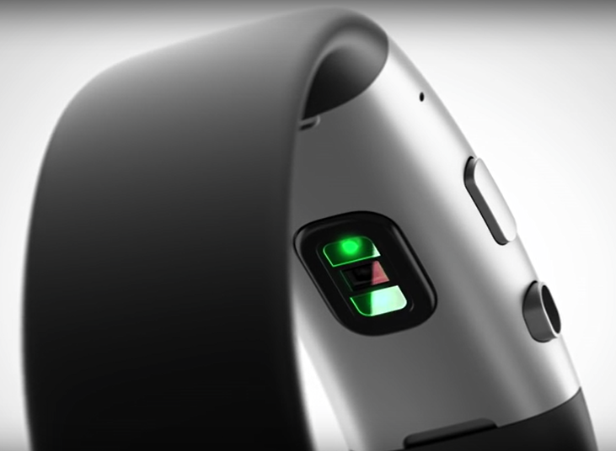
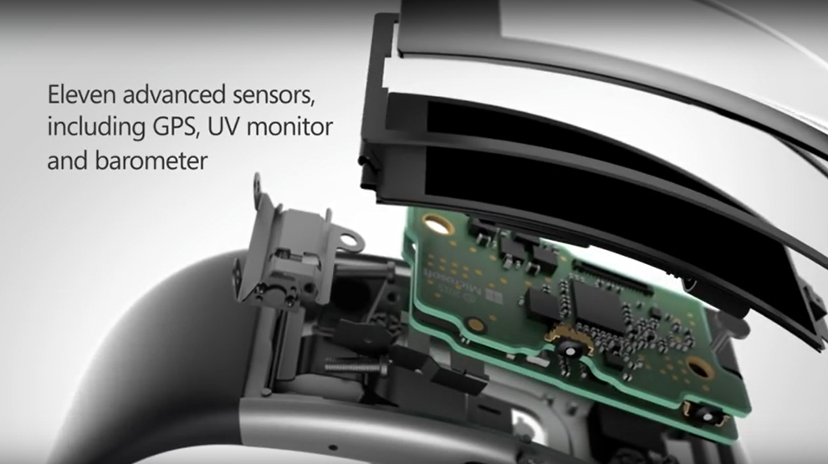
Microsoft Band
All day wearable device
Live healthier, be more productive
Stay connected at a glance

Slide 21
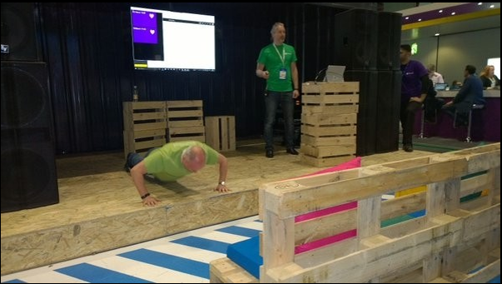
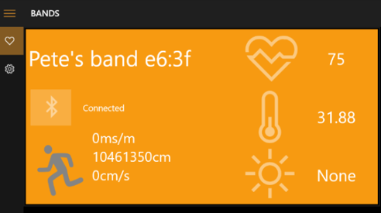

http://github.com/BandOnTheRun/

Slide 22
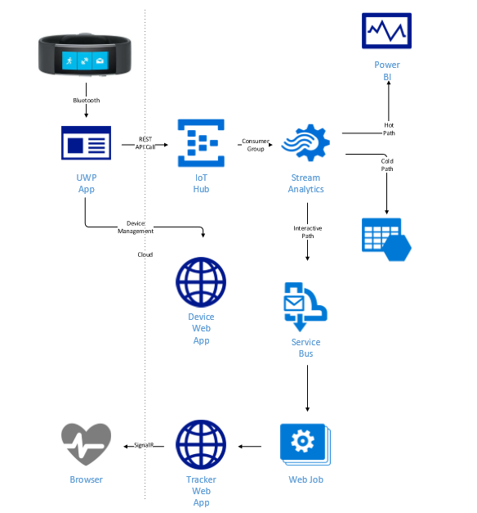
Band on the Run Architecture

